Slide 1


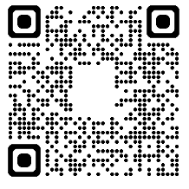
Regal Movie
Fundraiser
Want to beat the heat or just stock up for the holiday breaks? Enjoy a show and support MME PTA!
Regal Cinemas will donate 25% of each movie ticket bundle sold back to the school when you buy via our fundraising sales page:
https://www.groupraise.com/offer-campaigns/83714-mme-pta-regal-fundraising-campaigns
Treat yourself, friends, and family to an awesome movie night in support of a great cause!
Tickets can be used at any Regal location in the United States, including the F Street Theater.
Tickets have no expiration date.

